Slide 1
Project work
gruppo 2 - software architecture design 2024/2025
2nd sprint release presentation

Slide 2
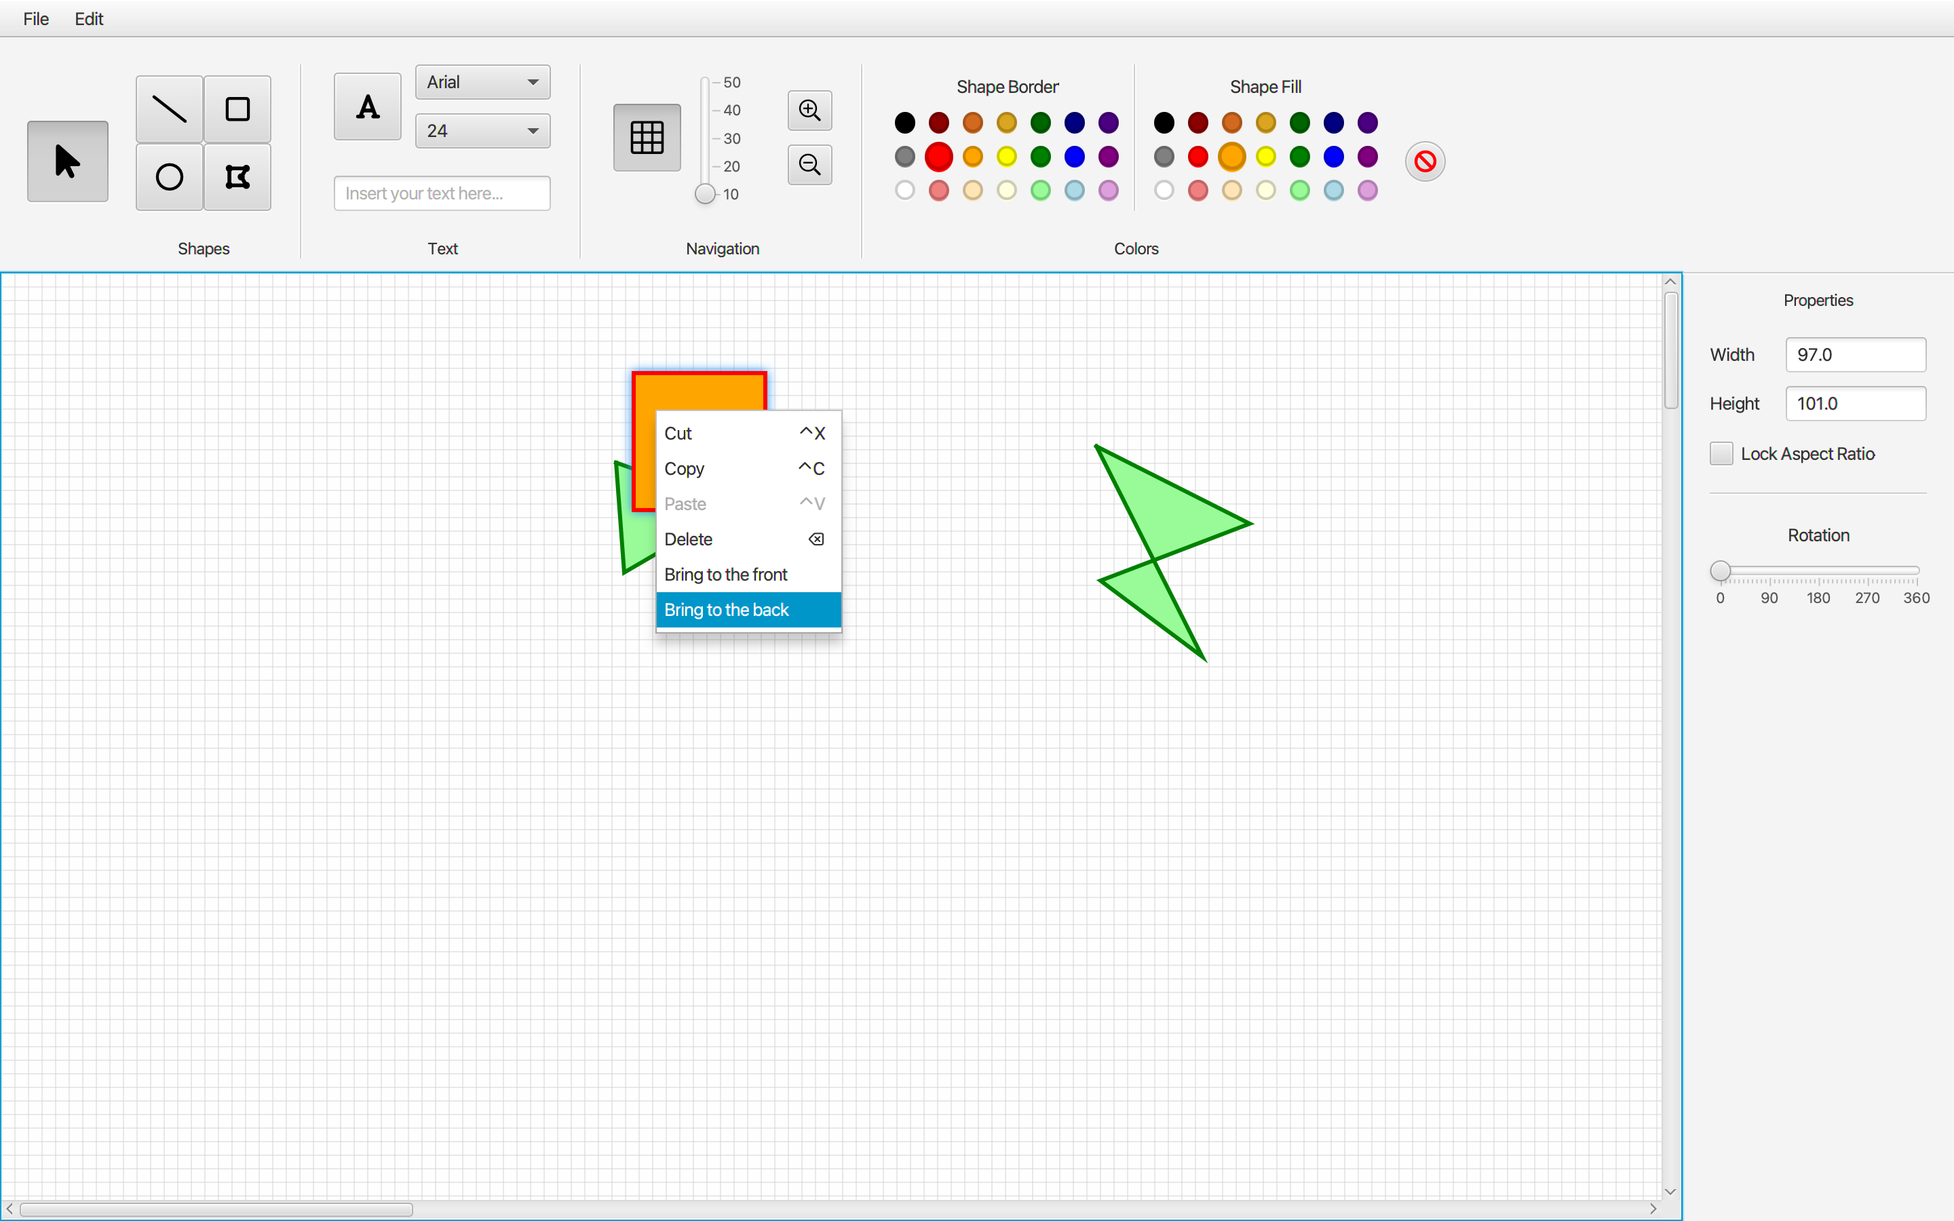
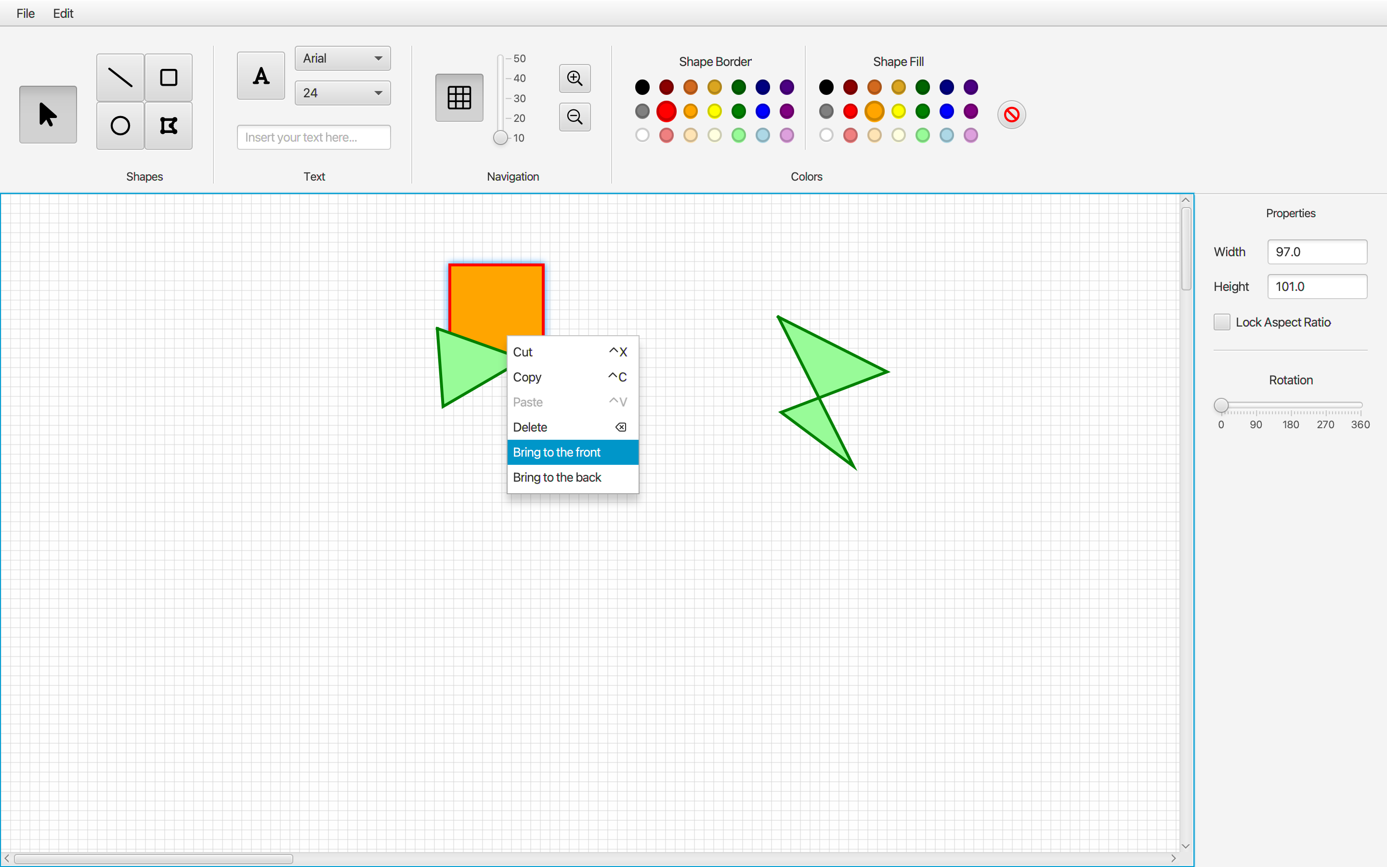
2nd sprint release
(Fig. 1) Bring To Back functionality
(Fig. 2) Bring To Front functionality

Slide 3
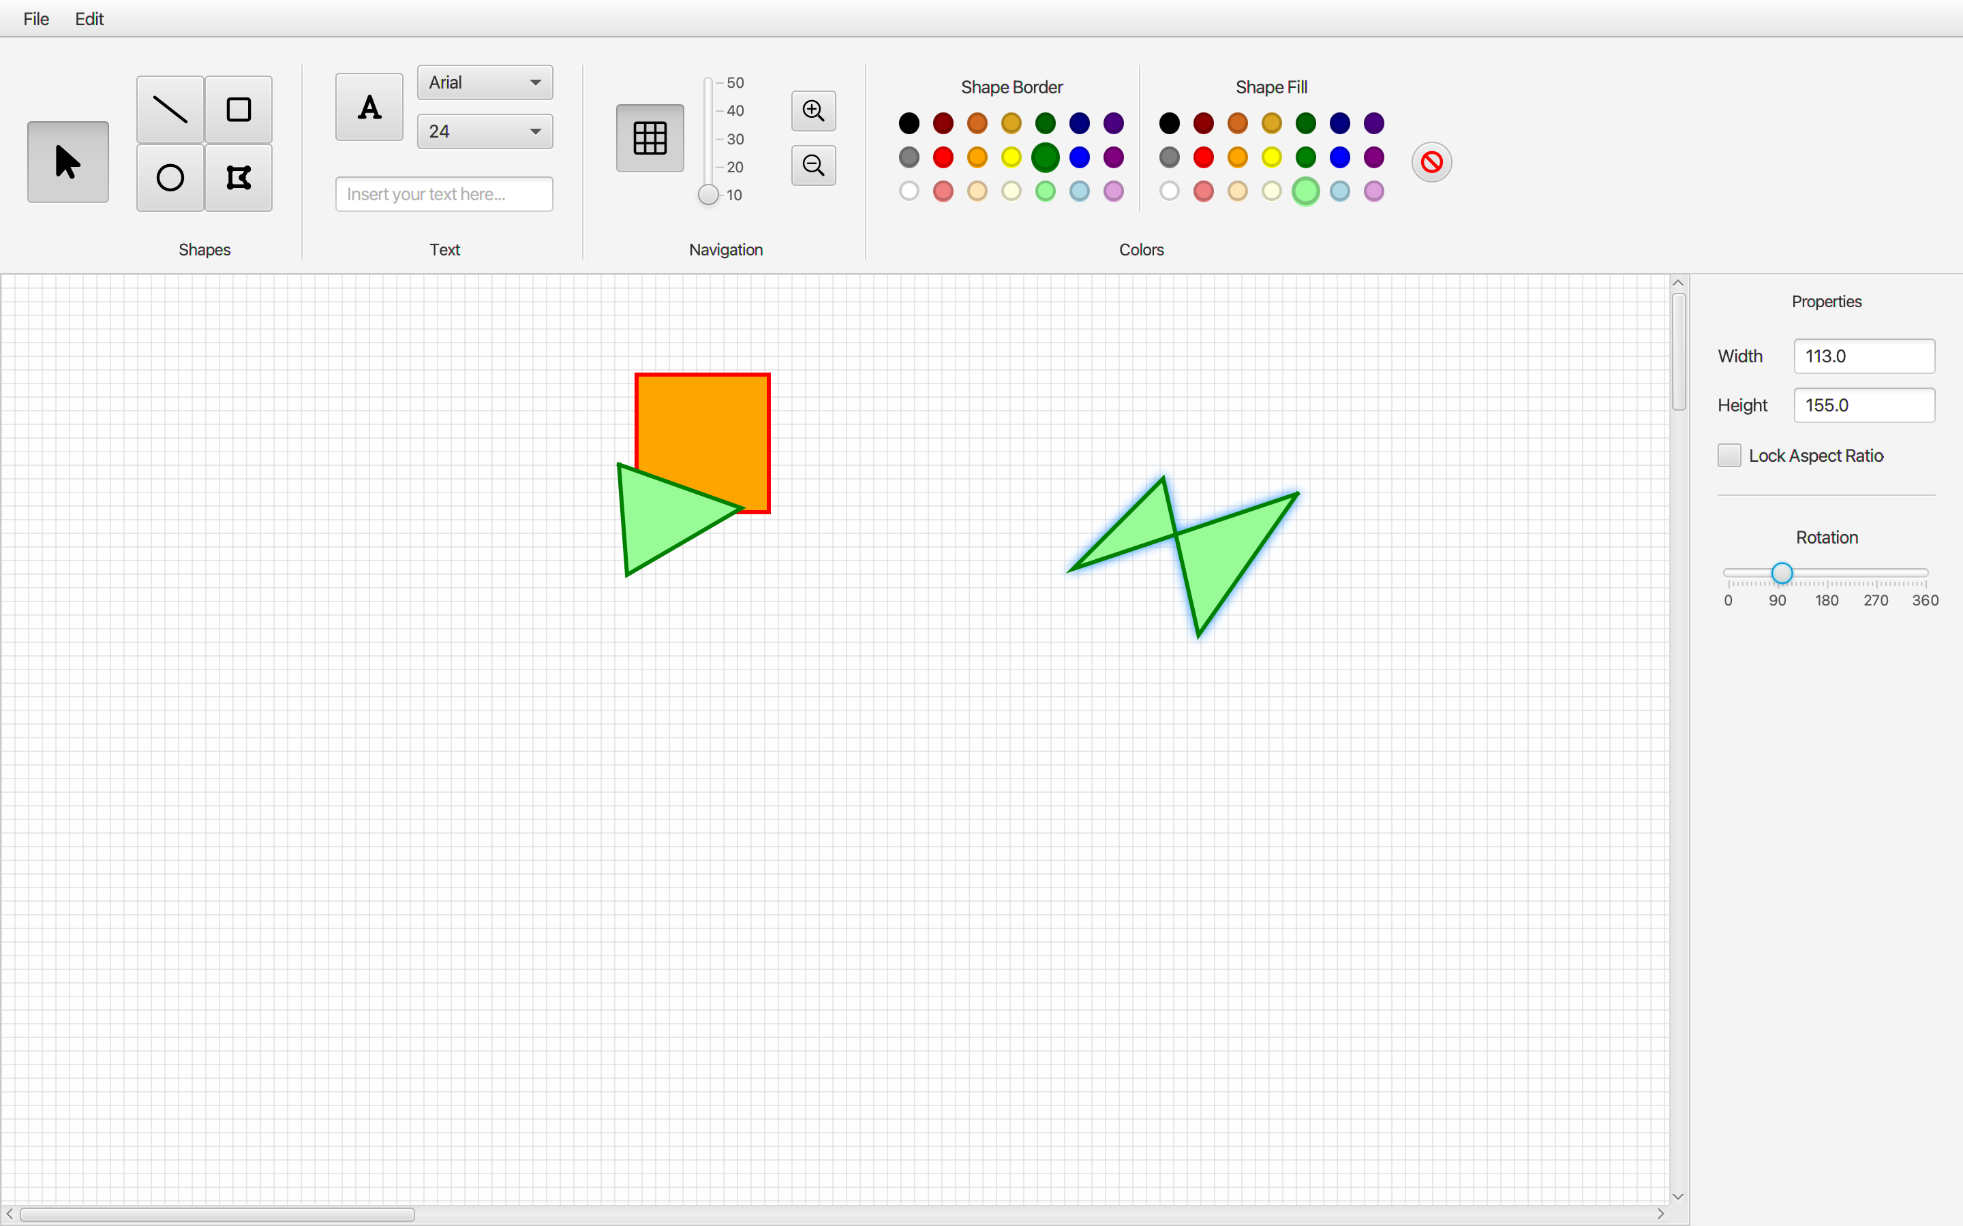
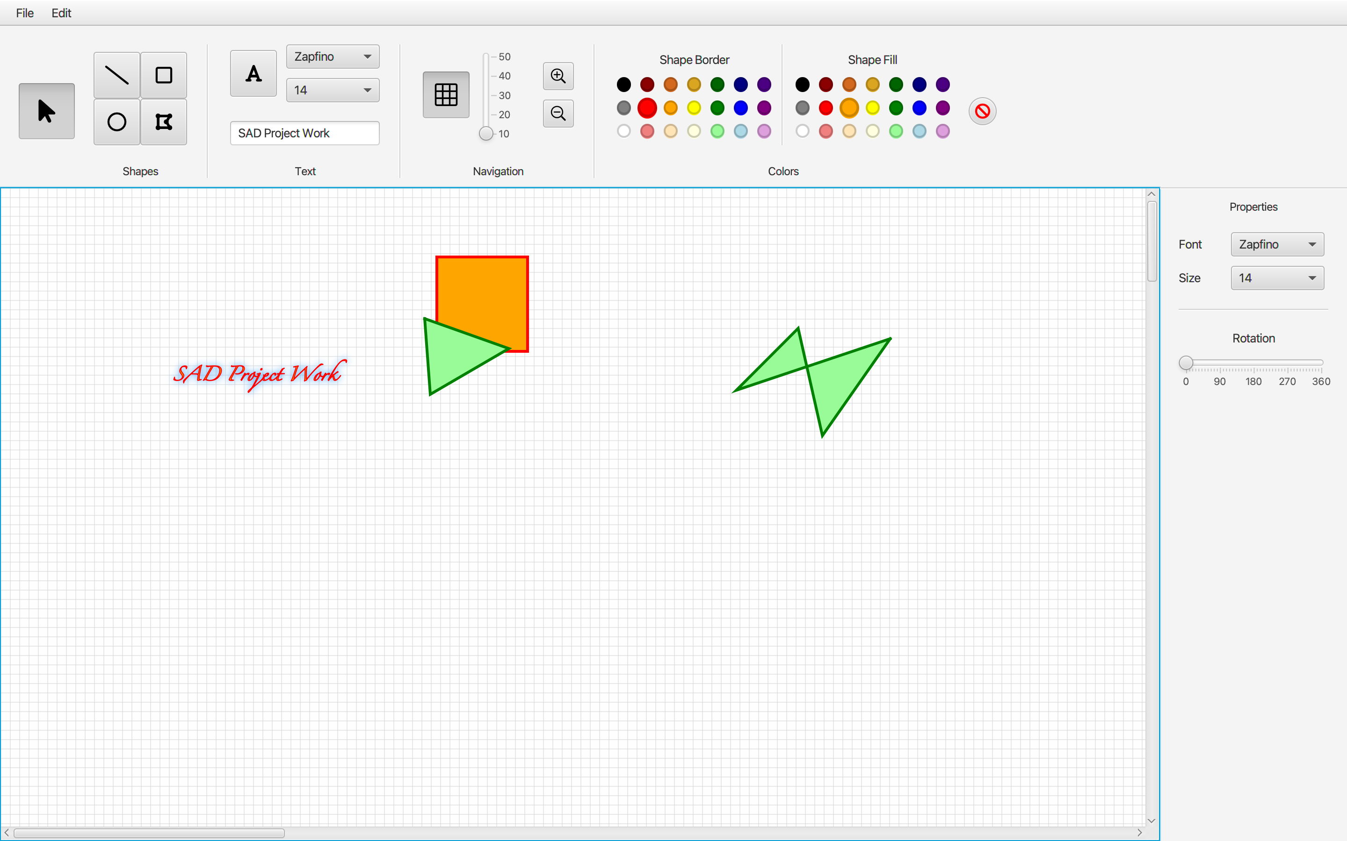
2nd sprint release
(Fig. 3) Rotation functionality
(Fig. 4) Text as a shape functionality

Slide 4
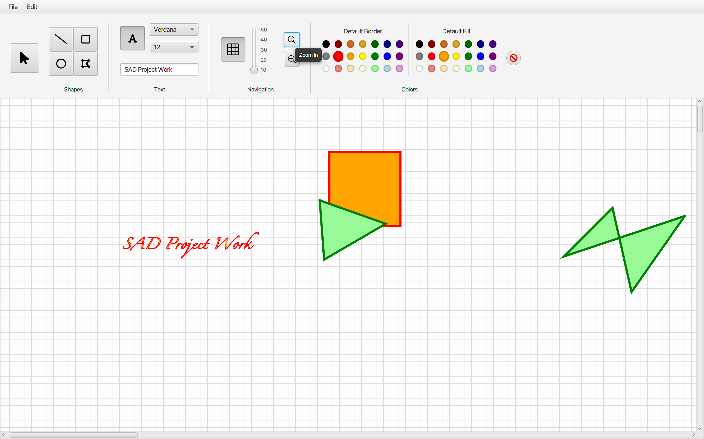
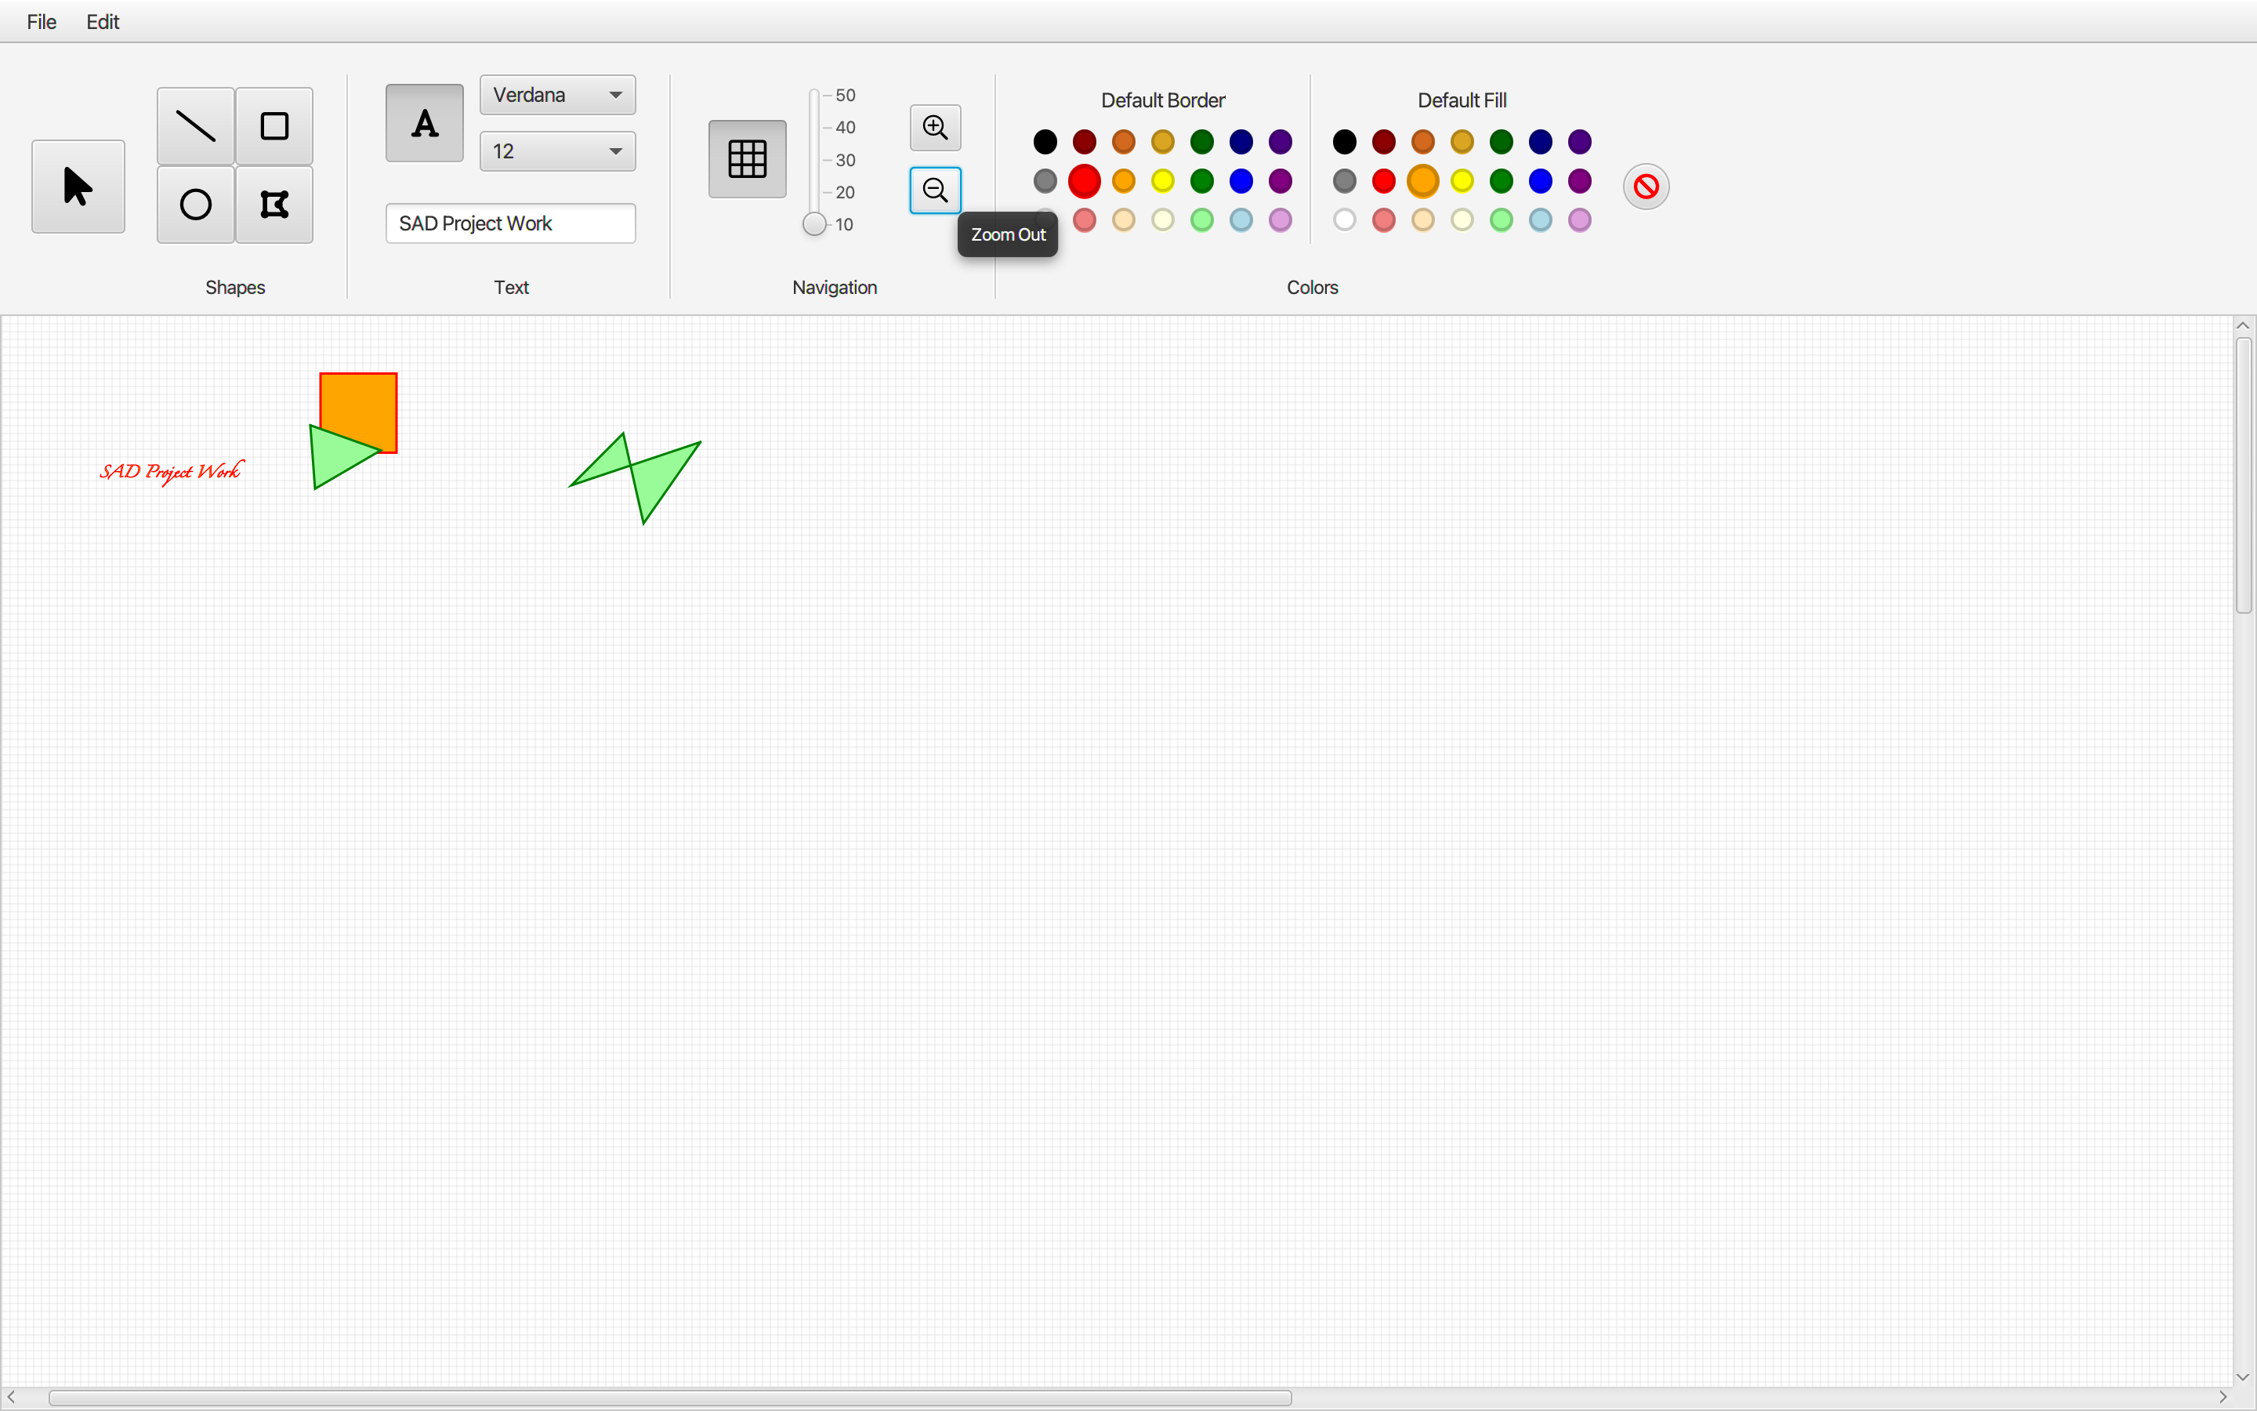
2nd sprint release
(Fig. 5) Zoom in functionality
(Fig. 6) Zoom out functionality

Slide 5
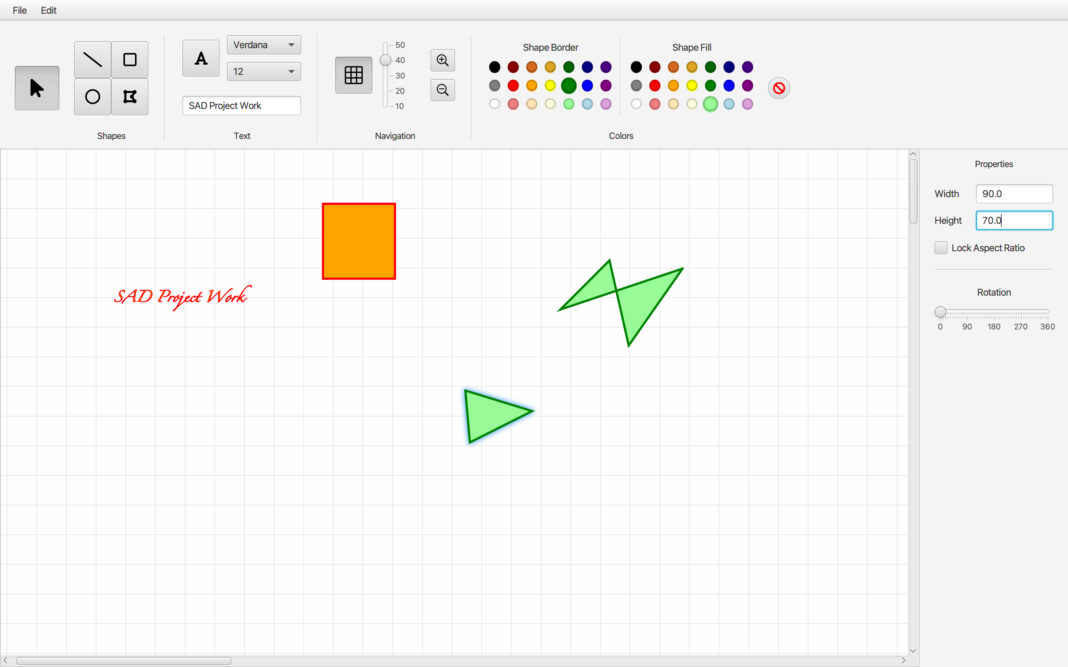
2nd sprint release
(Fig. 7) Stretch functionality

Slide 6
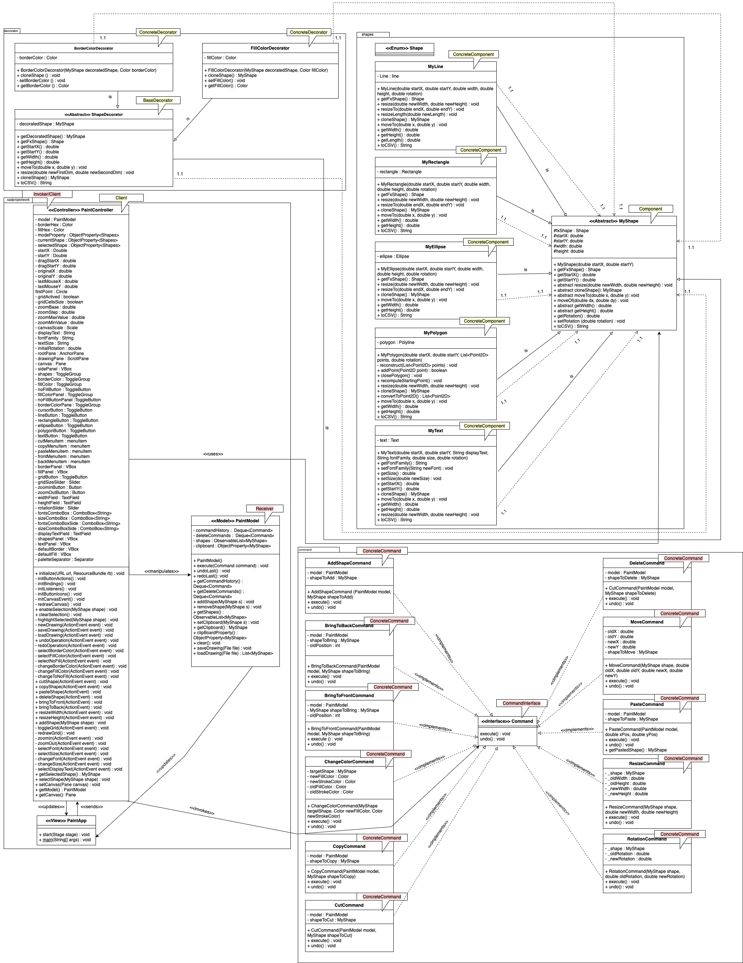
2nd sprint release - CLASS DIAGRAM
(Fig. 8) Class Diagram produced up 2nd sprint

Slide 7
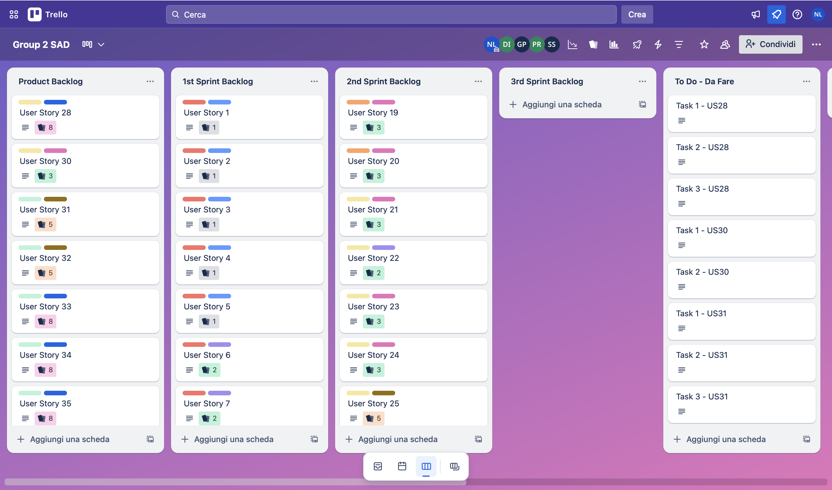
2nd sprint review
All planned user stories were completed.
In addition, user stories n. 27 and user story n. 29 planned for the next sprint were completed.
Therefore, it was decided to increase the project velocity from 32 story points to 35 story points.
(Fig. 9) Trello Board at the end of 2nd sprint

Slide 8
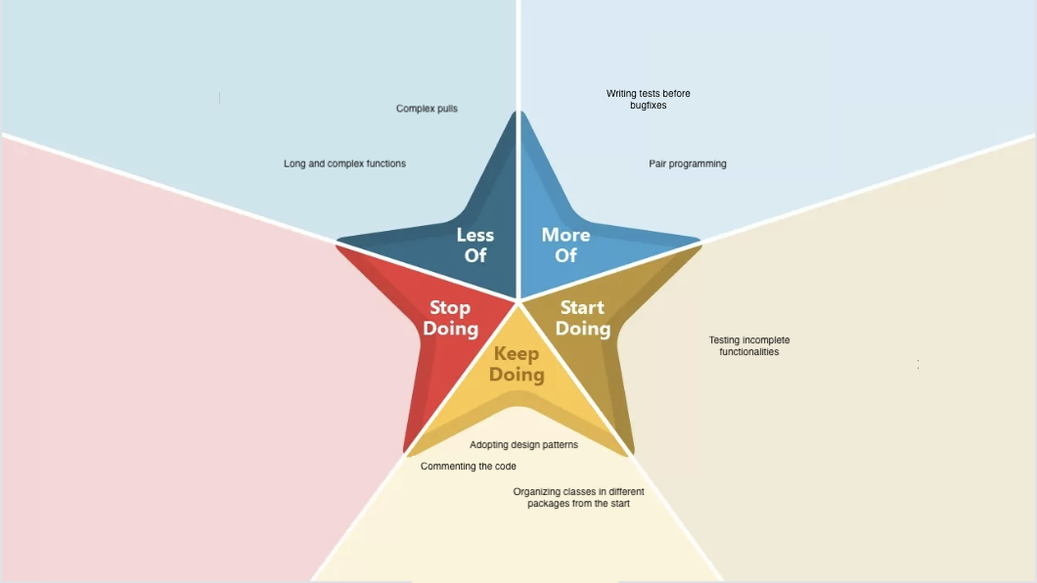
2nd sprint retrospective

Slide 9
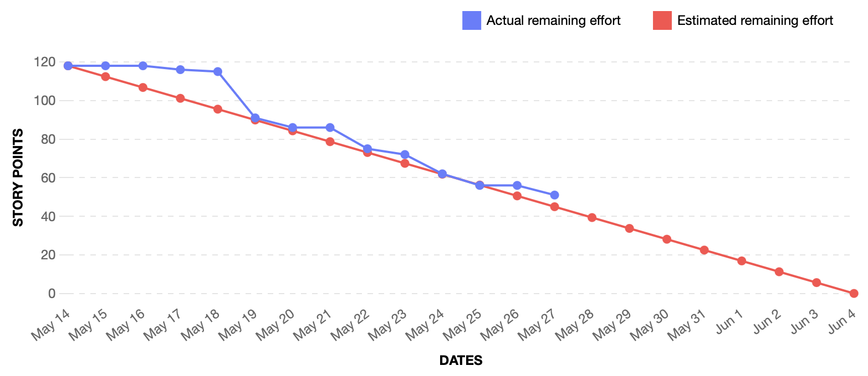
Burndown chart
(Fig. 10) Burndown chart at the end of 2nd sprint

Slide 10
3rd sprint backlog
The third sprint was devoted to more advanced and complex functions, such as figure grouping and the command to create new figures.
On the right there are some examples.
#US | Description | Priority | SPs
28 | Mirror | Could | 3
30 | Multiple Selection | Could | 3
31 | Group | Won’t | 5
32 | Ungroup | Won’t | 5
33 | New Shape Command | Won’t | 8

Slide 11
THANK YOU for attention
Iannone Davide
Lomazzo Noemi
Petrone Gianluca
Sirica Simone

